Slide 1
Water Pollution
8.E.1.4
Conclude that the good health of humans requires:
Monitoring of the hydrosphere
Water quality standards
Methods of water treatment
Maintaining safe water quality
Stewardship

Slide 2
Water Pollution
All organisms need water to carry out life processes
Many even live in the water
Because of its importance, it is essential to protect Earth’s water resources and use them wisely
Stewardship
Following practices that protect Earth’s resources

Slide 3
Pollution
The prevailing thought for many years is that there would always be a supply of clean water.
People dumped chemicals and waste into the water supply hoping it would wash out to see where it would not cause any problems
Pollution is a release of an unwanted substance into the environment
Pollutant
Any substance that can harm the environment

Slide 4
Pollution
Pollutants include:
Toxic chemicals
Human and animal waste
Fertilizers
Pesticides
They run off the land into rivers, lakes, and oceans
Pollution in our back yard

Slide 5
Sources of Water Pollution
Point-source pollution
Pollution that comes from a single site
Examples:
Oil spilling from a supertanker
Waste spilling from a drainpipe into a river
Non-point-source pollution
Pollution that comes from many places or an unidentified source
Examples:
Fertilizers
Animal waste

Slide 6
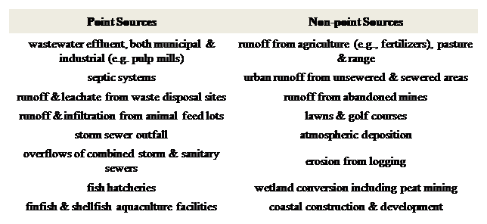

Slide 7
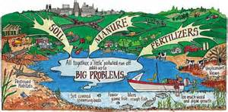
Nutrients and Water Pollution
In order to give plants additional nutrients, people add nutrient-rich fertilizers to the soil
Excess nutrients flow into the water supply

Slide 8
Nutrient and Water Pollution
Fertilizer is made of two nutrients
Phosphates
Nitrates
Too much of either one can create an algal bloom
Extremely rapid growth of algae
Some of this algae can harm other organisms
Pfiesteria is a local type of algae that is harmful
North Carolina Fish Kill

Slide 9
Nutrients and Water Pollution
Excess nutrients decreases the oxygen levels
When algae and other aquatic plants grow, they use up all of the resources and begin to die off
Decomposers then use up more oxygen while breaking down the remains
With even less oxygen in the water for fish:
They get sick
They die
This creates an area known as a Dead Zone
Lack of oxygen in a region where few organisms can live
Dead Zone Video

Slide 10
Pollution of Groundwater
Rain is a major cause of pollution
Rain water runs along the surface of the land
It often picks up chemicals such as road salt and fertilizers
Some of the water seeps into groundwater
Once in the groundwater it often reaches aquifers
If people wells into one of these aquifers, they will be tapping polluted water

Slide 11
Local Water Issues
North Carolina Water Concerns
Final Thoughts
Controversial Video on Mans Role in Environment

