Slide 1
Biotechnology

Slide 2
What is Biotechnology
Any technology based on a biological system or organism
Uses organisms to solve real world problems
Used to domesticate animals and plants
Creates safer food sources

Slide 3
What is Biotechnology
More recently:
Alter genes of organisms
Clean up wastes
Generate cheaper foods
Create fuel sources
Also used in forensics, medicine, agriculture and food processing

Slide 4
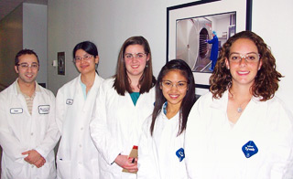
Careers in Biotechnology
Bioengineers
Apply engineering principles to living systems.
Create products that meet human needs.
Sciences included
Microbiology
Computer Technology
Robotics
Molecular Biology
Biochemistry
Pharmacology
Immunology
Explore Careers

Slide 5
Biotechnology in Forensics
Forensic Science
Branch of study associated with the legal system
Uses physical evidence
Fingerprints
Bullet casings
Blood splatter
Uses biotechnology
Blood typing
DNA analysis

Slide 6
Biotechnology in Forensics
You are NOT the father!
Scientists use blood type information to establish a child's biological parent.
Humans have four blood types:
A, AB, B, and O
Different blood types can not match up together such as a child with blood type O can not have a mother with blood type AB

Slide 7
Biotechnology in Forensics
DNA Analysis takes a specific portion of a persons DNA and uses laboratory techniques to examine it more closely
This is a more accurate way to prove who a parent is.
Once the DNA of a child is mapped, they compare it to the suspected parent to find similarities.
This is also used in criminal cases to locate suspects.
DNA analysis cannot be used to find a criminal, there must be a sample to compare to the collected DNA.

Slide 8
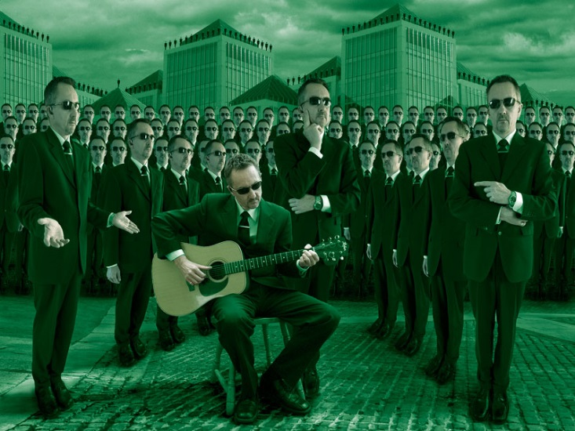
Biotechnology in Medicine
The medical industry has many uses
Genetic testing
Gene therapy
Cloning
Tissue culturing
Development of better drugs

Slide 9
Biotechnology in Medicine
Genetic Testing
Takes a DNA sample and breaks it apart
Human Genome Project
Mapping the human genome
Used to screen for diseases
Breast Cancer is an example
Gene Therapy
Utilizes viruses or bacteria to enter a cell and replace defective genes
Believed to be the best way to cure diseases once they have been identified

Slide 10
Biotechnology in Medicine
Cloning
Creation of genetically identical organisms
Many organisms have be cloned
“Dolly the sheep” is the most famous
Examples of cloning
Tissue Culturing
Allows bioengineers to grow human tissues and organs in the laboratory
Human ears, livers and heart cells have been grown
Hoped to be used in organ transplants

Slide 12
Biotechnology in Medicine
Drug Development
process of bringing a new drug to the market once a lead compound has been identified.
One example is bioengineered bacteria used to treat diabetes
Gene used to produce insulin is inserted into bacteria cells.
The bacteria reproduces quickly producing large amounts of insulin
Also used to create cheaper antibiotics

Slide 13
Human Genome Project
Genomics
The study of an organism’s entire genome, including DNA sequencing
Used to study how the body works
Used to understand how each body is unique
Personalized Medicine
The use of a patient’s genome to select treatment that is suited to a patient’s individual genes
The goal is to develop medicine unique to an individual.

Slide 15
Biotechnology in Microbiology
Microbiology
Field of science that studies microbes
Microbes can work for and against humans
Bacteria in our intestines absorb vitamins and minerals
Bacteria in soil help plants trap nitrogen for growth
Microbes are natures garbage men
Process waste
Recycle matter

Slide 16
Biotechnology in Microbiology
Bioremediation
Uses microbes to remove harmful toxins from the environment
Gulf Coast Oil Spill
Bioremediation Explaination

Slide 17
Biotechnology in Microbiology
Used in sewage treatment plants
Harmful chemicals have been used in the past
These have been replaced with microbes
They do the job faster
Cheaper
Do not leave behind harmful pollutants
Now being used in household cleaners
Breakdown in sunlight

Slide 18
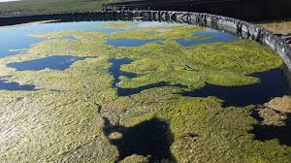
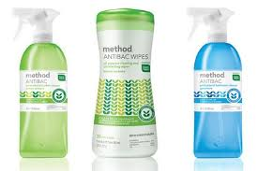
Sewage treatment plant, microbes are cleaning the waste

Slide 19
Biotechnology in Agriculture
Oldest form of biotechnology
Uses artificial (not natural) selection
Increasing yields
Decreases crop stress
Produces food quality
Also used with animals
Produces more milk, meat, or wool
Does so quicker than ever before

Slide 20
Biotechnology in Agriculture
Transgenic Crops
Organisms that have genes from a different species artificially inserted into their genome.
Plants can be altered to grow more quickly, flower earlier, produce more flowers, and even grow more fruit
Insecticides
Chemicals that kill insects
Insect Resistant Crops
Crops modified to produce their own insecticides
Bt Corn
Specific example of insect resistant crop
Bacillus thuringiensis
Bt Corn Video

Slide 21
Reducing Environmental Stressors
Scientists have noticed that weeds grow in harsh conditions and environments
The genes are inserted into transgenic crops
Tomatoes, corn, wheat, rice, or barley
This allows domestic crops to grow in harsh conditions and even survive droughts

Slide 22
Improving Food Quality
This is an important goal of biotechnology
Scientists can control
Size
Taste
Amount of nutrients
When it ripens
How long it stays fresh
All this helps control costs and allows people to become healthier while reducing disease.

Slide 23
Improving Food Quality
Golden Rice
An example of a crop that has been genetically modified to improve its quality
Makes beta-carotene in its grains
Beta-carotene is needed to make vitamin A
Developed to stop malnutrition in Africa and Southeast Asia
Children in these areas regularly ate food with too little vitamin A
Too little vitamin A can cause disease, illness, blindness, and even death

Slide 24
Ethical Issues in Biotechnology
Fear of impact of modified crops
Unforeseen consequences
Cross pollinate with wild plants
Harm to people with food allergies
Body reactions to new crops/foods
Can they cause diseases?
Ethical questions
Is it a good idea?
Human Genome project
Who owns the information?
Who gets to decide what is a good/bad use?
Can we alter the gene to produce specific results?
Design your own baby?
Ethical Issues Video

Slide 25
Biotechnology in North Carolina
Research Triangle
Raleigh/Durham/Chapel Hill
Cutting edge research at local Universities attracts many companies that perform tech research and biotech research.
Creates jobs in North Carolina
Largest research park in the United States

Slide 26
Which of the following is not a strategy for increasing crop yields?
Decreasing weeds
Decreasing pests
Increasing the growth rate of the crop plant
Decreasing the number of crop plants

Slide 27
What would be the result of removing all bacteria from the intestine of a human?
Improved digestion
More digestive problems
Decreased vitamin A absorption
Increased disease resistance

Slide 28
Which of the following is not a criticism of transgenic crops?
They do not grow as large or produce as much
They can cross pollinate with wild plants
They can cause allergies in humans
They can cause unknown diseases in humans

Slide 29
A student wants to be a bioengineer. Which of the following fields would not be a proper field of study for him/her to choose in college?
Biochemistry
Microbiology
Social Studies
Pharmacology

Slide 30
Golden rice is a bioengineered form of rice that has high vitamin A content. What is golden rice attempting to do?
Grow rice in salty soil
Grow rice under drought conditions
Create better looking rice
Create rice that contains more nutrients

Slide 31
